Slide 1

DESIGN AND ANALYSIS OF ALGORITHMS (113939)
Dr. Owais Hussain

Slide 2

Agenda
Heaps
Heapify
Priority Queues

Slide 3
Sample 2
Binary Heap
Binary Heap is a Binary Tree which is:
ALWAYS complete.
Each Parent node is either the smallest or the largest element.
In Min heap, the element at root node is the smallest and each parent node is smaller than all its children.
In Max heap, the element at root node is the largest and each parent node is larger than all its children.
One of the most important uses of Heap is in implementing Priority Queues.

Slide 4
Sample 2
Binary Heap
In Min heap, the element at root node is the smallest and each parent node is smaller than all its children.
Assume the data to be: 4967, 4910, 5144, 5073, 4930, 5040, 4901, 5019, 5139, 4669, 4946
Th Min Heap will be like the first tree.
Max Heap will look like the second tree.
4669
4901
4930
5073
4967
4910
4946
5040
5019
5139
5144
4967
4910
5144
5139
4946
5040
4901
5073
5019
4669
4930

Slide 5
Sample 2
Binary Heap
INSERT operation in Max heap:
If the heap is empty, then Insert the element at the root.
Otherwise:
Insert the element at the last free space in complete binary tree.
If the element is greater than its parent, then swap with the parent.
Keep on repeating until the inserted element is the larger than its parent element.
The time complexity of INSERT operation is based on the number of SWAP operations.

Slide 6
Sample 2
Binary Heap
INSERT 5150 in the following Heap
4967
4910
5144
5139
4946
5040
4901
5073
5019
4669
4930
5150
4967
4910
5144
5139
4946
5040
4901
5073
5019
4669
4930
5150
4967
4910
5144
5139
4946
5150
4901
5073
5019
4669
4930
5040
4967
4910
5150
5139
4946
5144
4901
5073
5019
4669
4930
5040

Slide 7
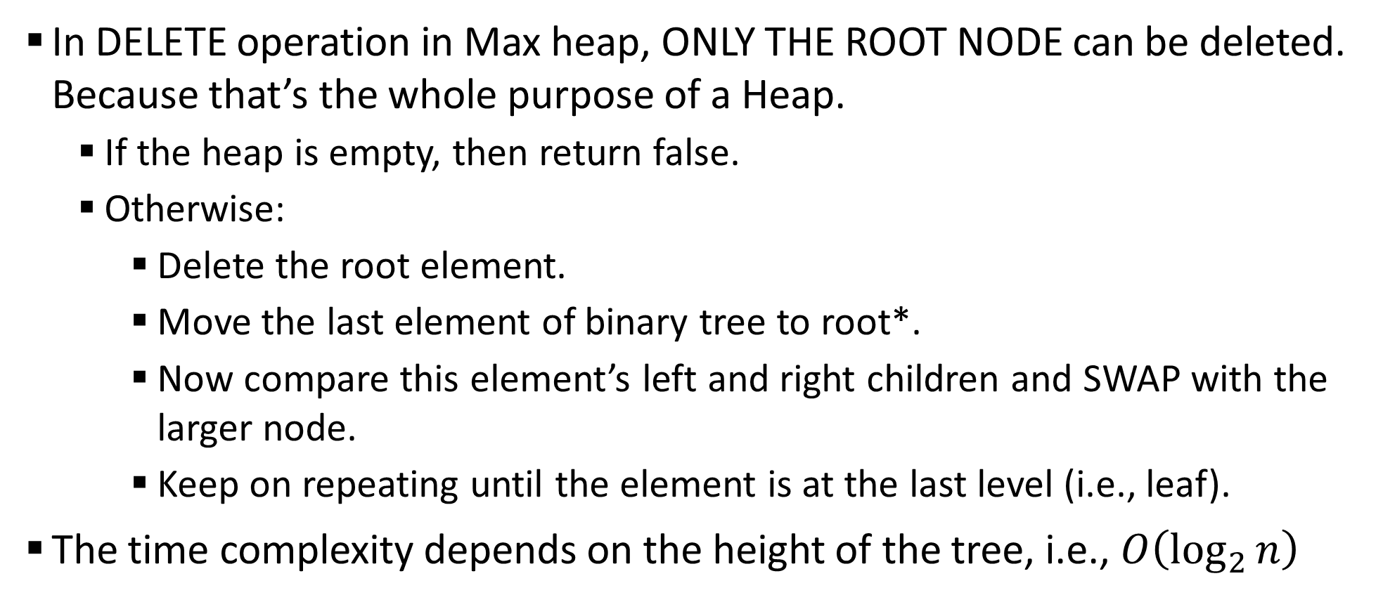
Sample 2
Binary Heap
In DELETE operation in Max heap, ONLY THE ROOT NODE can be deleted. Because that’s the whole purpose of a Heap.
If the heap is empty, then return false.
Otherwise:
Delete the root element.
Move the last element of binary tree to root*.
Now compare this element’s left and right children and SWAP with the larger node.
Keep on repeating until the element is at the last level (i.e., leaf).
The time complexity depends on the height of the tree, i.e., $O\left(\log_{2}{n}\right)$
Notes:
In delete operation, the last element is chosen to be moved to maintain completeness property.

Slide 8
Sample 2
Binary Heap
DELETE 5150 from the following Heap
4967
4910
5150
5139
4946
5144
4901
5073
5019
4669
4930
5040
4967
4910
5139
4946
5040
5073
5019
4669
4930
5150
4901
4967
5139
4910
4946
5040
5073
5019
4669
4930
5150
4901
4967
5139
5073
4946
5040
4910
5019
4669
4930
5150
4901
Can you guess the last step?

Slide 9
Sample 2
Heap Sort
Heap Sort is one of the most efficient sorting algorithms.
Once we implement a Heap, then this algorithm is fairly simple with only 2 steps.
Given an array of unsorted values:
INSERT all values in Min Heap.
DELETE all values from the Heap and collect into a linear array.
The array will be sorted.
Similarly, to sort an array into reverse order, use Max Heap.

Slide 10
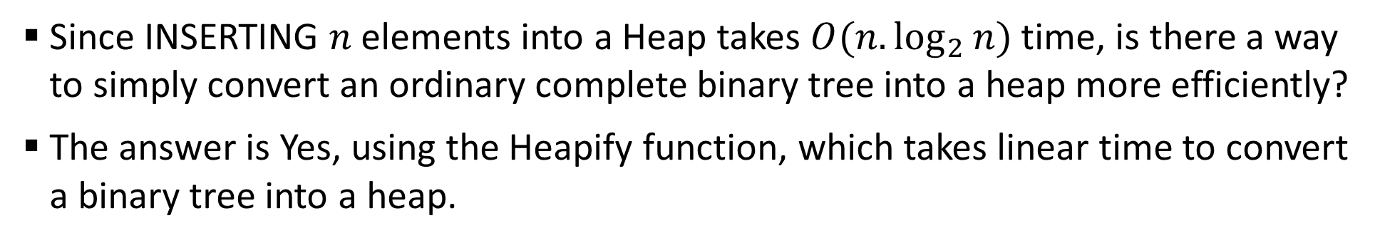
Sample 2
Heapify
Since INSERTING $n$ elements into a Heap takes $O(n.\log_{2}{n})$ time, is there a way to simply convert an ordinary complete binary tree into a heap more efficiently?
The answer is Yes, using the Heapify function, which takes linear time to convert a binary tree into a heap.
4967
5051
4669
5019
5187
5144
5139
3826
4901
4930
5073
4946

Slide 11
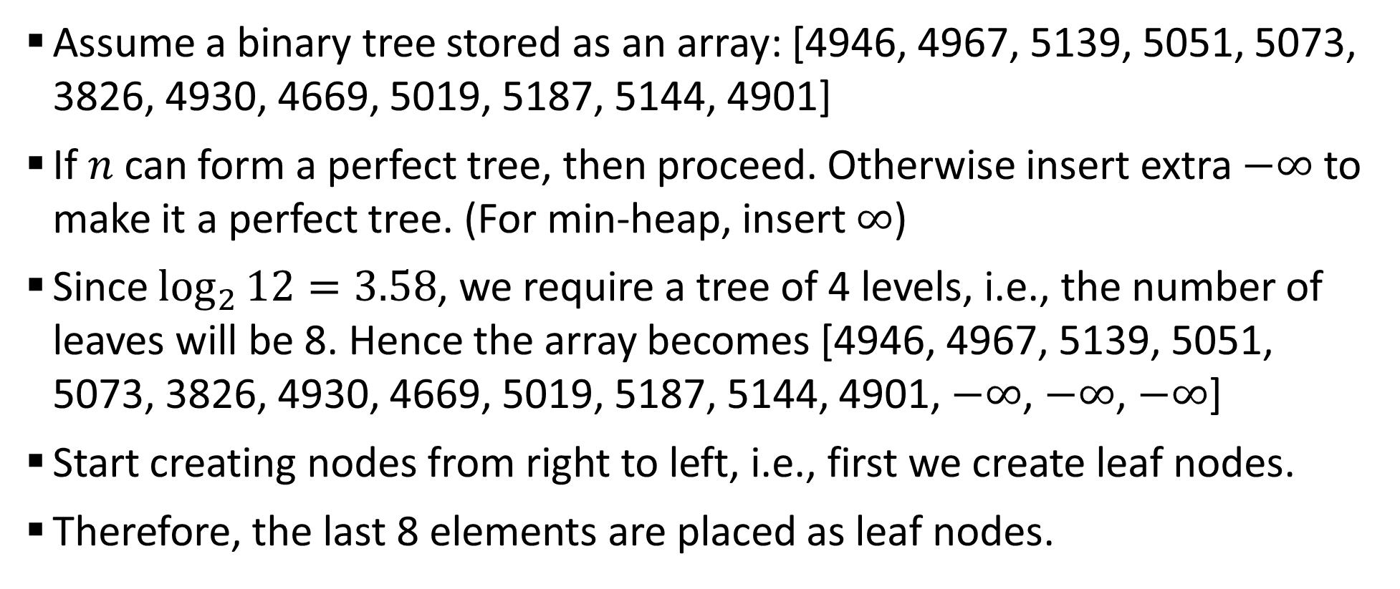
Sample 2
Heapify
Assume a binary tree stored as an array: [4946, 4967, 5139, 5051, 5073, 3826, 4930, 4669, 5019, 5187, 5144, 4901]
If $n$ can form a perfect tree, then proceed. Otherwise insert extra $−∞$ to make it a perfect tree. (For min-heap, insert $∞$)
Since $\log_{2}{12=3.58}$, we require a tree of 4 levels, i.e., the number of leaves will be 8. Hence the array becomes [4946, 4967, 5139, 5051, 5073, 3826, 4930, 4669, 5019, 5187, 5144, 4901, $−∞$, $−∞$, $−∞$]
Start creating nodes from right to left, i.e., first we create leaf nodes.
Therefore, the last 8 elements are placed as leaf nodes.

Slide 12



Sample 2
Heapify
The tree with leaf nodes; each node itself is a heap.
Now add elements from right to left and make sure they are also heaps.
4669
5019
5187
5144
4910
$$−∞$$
$$−∞$$
$$−∞$$
4669
5019
5187
5144
3826
$$−∞$$
−∞
$$−∞$$
−∞
$$−∞$$
−∞
4930
4910

Slide 13



Sample 2
Heapify
Note that 10 nodes were inserted with only 1 swap operation. Add another node
5144
4910
4930
4669
5019
5187
5073
3826
$$−∞$$
$$−∞$$
$$−∞$$
4669
5019
5144
5073
3826
$$−∞$$
−∞
$$−∞$$
−∞
$$−∞$$
−∞
4930
4910
5187

Slide 14



Sample 2
Heapify
Add remaining nodes
5051
5144
4910
4930
4669
5019
5187
5073
3826
$$−∞$$
$$−∞$$
$$−∞$$
4669
5019
5144
5073
3826
$$−∞$$
−∞
$$−∞$$
−∞
$$−∞$$
−∞
4930
5139
5051
5187
4910

Slide 15
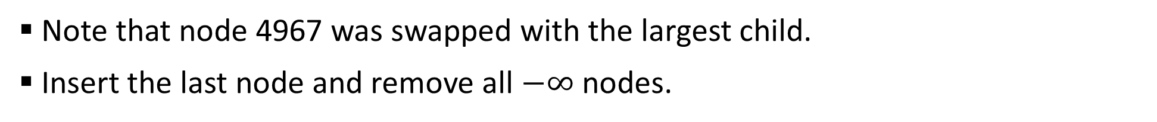
Sample 2
Heapify
Note that node 4967 was swapped with the largest child.
Insert the last node and remove all $−∞$ nodes.
4669
5019
4967
5073
3826
$$−∞$$
−∞
$$−∞$$
−∞
$$−∞$$
−∞
4930
5139
5051
5144
5187
4910

Slide 16
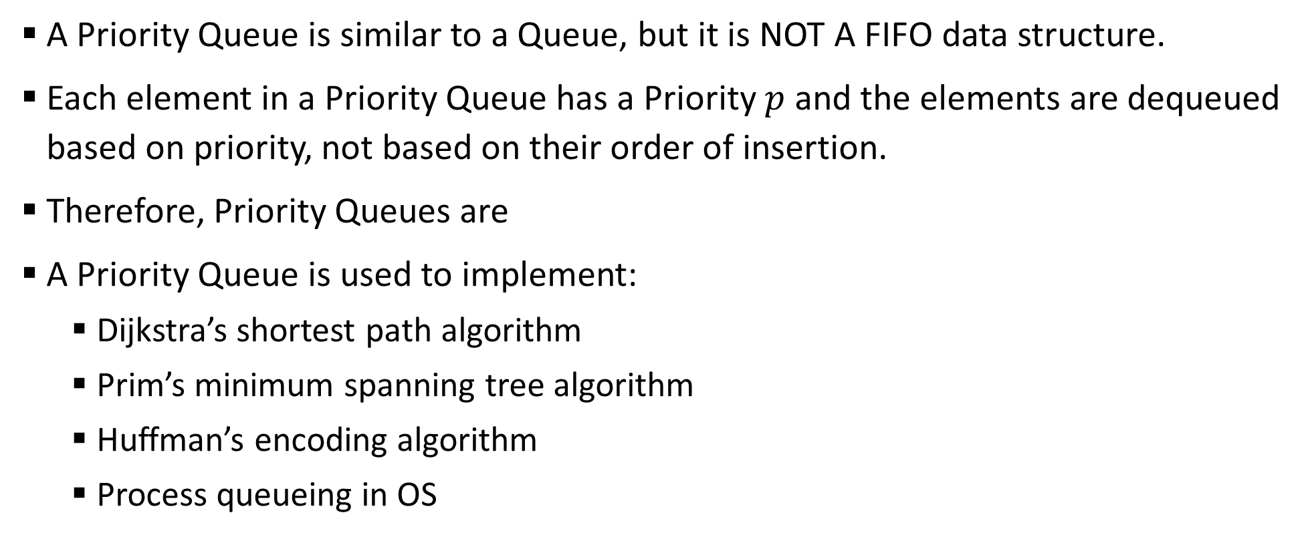
Sample 2
Priority Queues
A Priority Queue is similar to a Queue, but it is NOT A FIFO data structure.
Each element in a Priority Queue has a Priority $p$ and the elements are dequeued based on priority, not based on their order of insertion.
Therefore, Priority Queues are
A Priority Queue is used to implement:
Dijkstra’s shortest path algorithm
Prim’s minimum spanning tree algorithm
Huffman’s encoding algorithm
Process queueing in OS

Slide 17
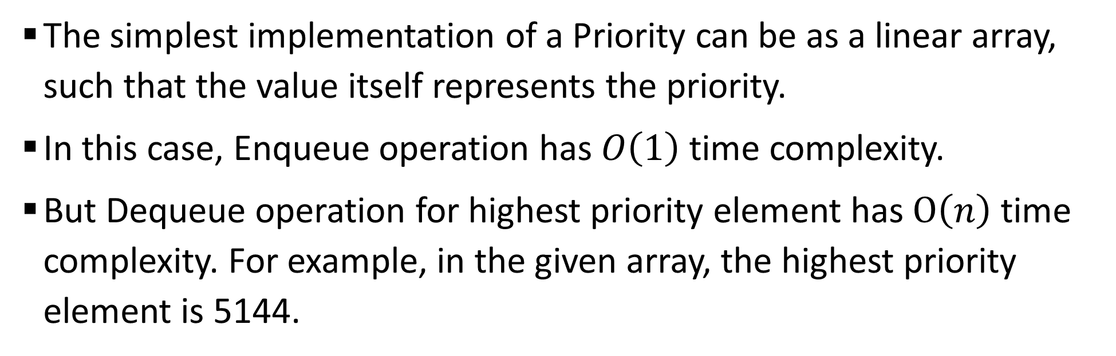
Sample 2
Priority Queues
The simplest implementation of a Priority can be as a linear array, such that the value itself represents the priority.
In this case, Enqueue operation has $O\left(1\right)$ time complexity.
But Dequeue operation for highest priority element has $O\left(n\right)$ time complexity. For example, in the given array, the highest priority element is 5144.
4669
5051
5073
5144
3826
4910

Slide 18
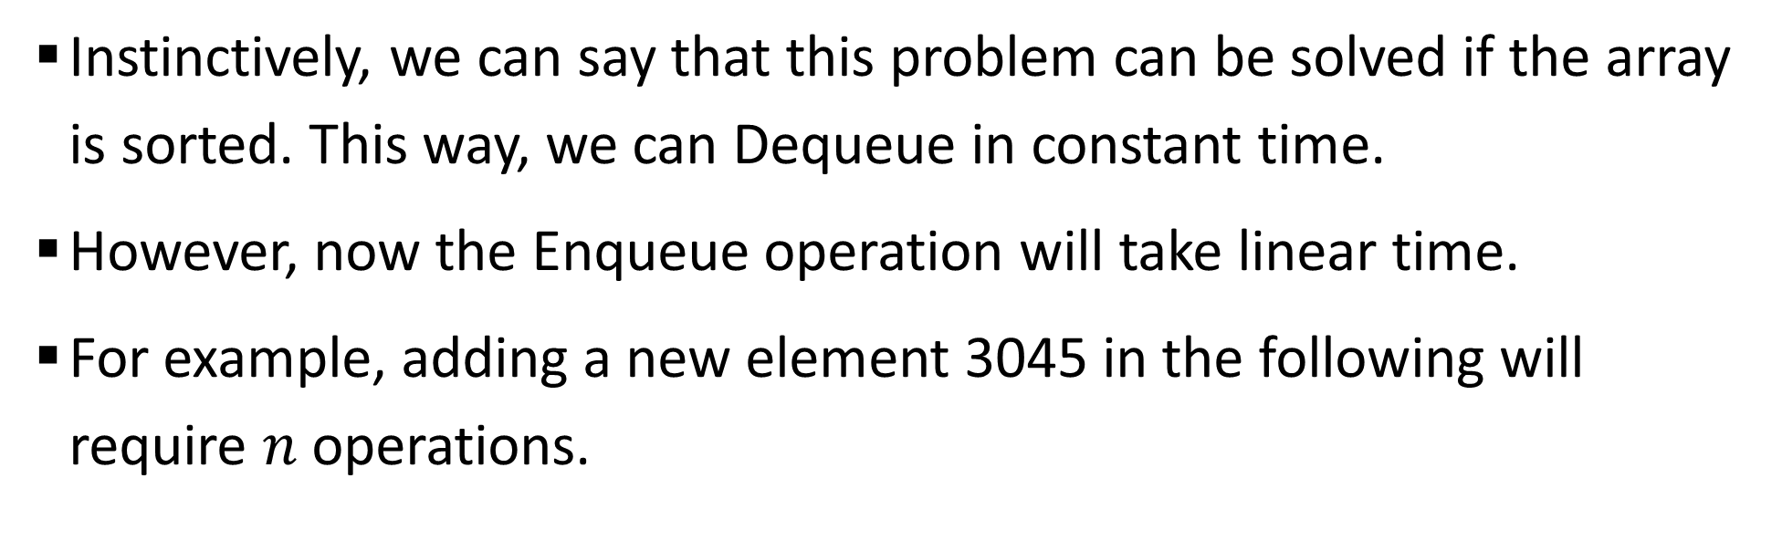
Sample 2
Priority Queues
Instinctively, we can say that this problem can be solved if the array is sorted. This way, we can Dequeue in constant time.
However, now the Enqueue operation will take linear time.
For example, adding a new element 3045 in the following will require $n$ operations.
3826
4669
4910
5051
5073
5144

Slide 19
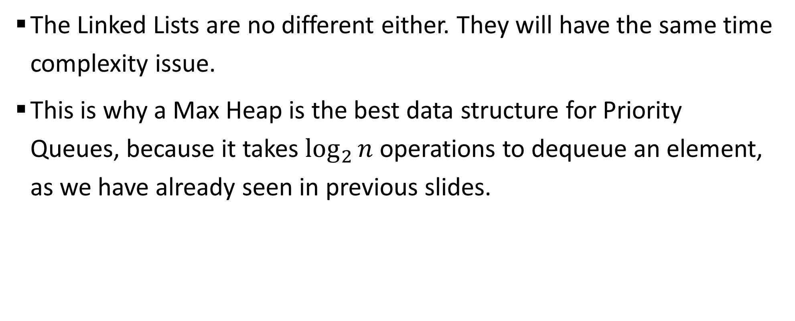
Sample 2
Priority Queues
The Linked Lists are no different either. They will have the same time complexity issue.
This is why a Max Heap is the best data structure for Priority Queues, because it takes $\log_{2}{n}$ operations to dequeue an element, as we have already seen in previous slides.

Slide 20
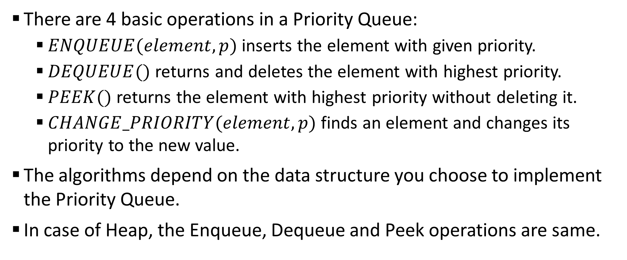
Sample 2
Priority Queues
There are 4 basic operations in a Priority Queue:
$ENQUEUE(element, p)$ inserts the element with given priority.
$DEQUEUE()$ returns and deletes the element with highest priority.
$PEEK()$ returns the element with highest priority without deleting it.
$CHANGE_PRIORITY(element, p)$ finds an element and changes its priority to the new value.
The algorithms depend on the data structure you choose to implement the Priority Queue.
In case of Heap, the Enqueue, Dequeue and Peek operations are same.

Slide 21
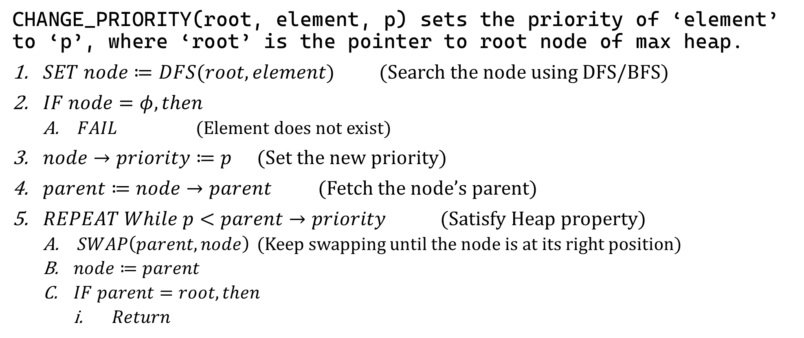
Sample 2
Priority Queues
CHANGE_PRIORITY(root, element, p) sets the priority of ‘element’ to ‘p’, where ‘root’ is the pointer to root node of max heap.
$SET node≔DFS(root, element)$ (Search the node using DFS/BFS)
$IF node=φ, then$
$FAIL$ (Element does not exist)
$node→priority≔p$ (Set the new priority)
$parent≔node→parent$ (Fetch the node’s parent)
$REPEAT While p<parent→priority$ (Satisfy Heap property)
$SWAP\left(parent,node\right)$ (Keep swapping until the node is at its right position)
$node≔parent$
$IF parent=root, then$
$Return$

Slide 22



THANK YOU
Owais Hussain
+92 345-3174270
owais.hussain@kiet.edu.pk
https://www.researchgate.net/profile/Owais-Hussain-3

